Slide 1
MCP vs Agentic AI
Tools vs Agents

Slide 2

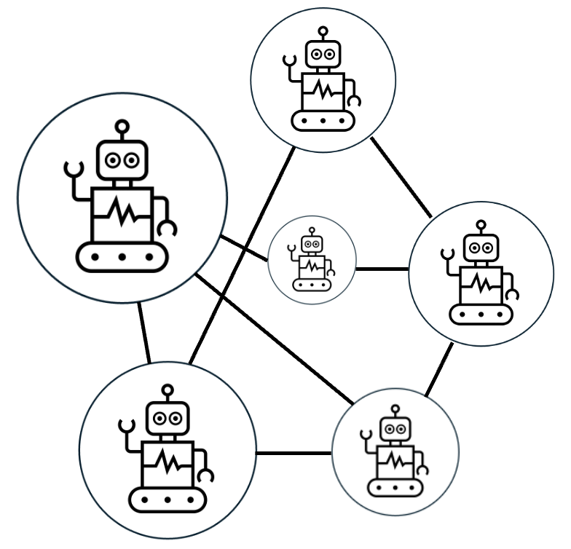

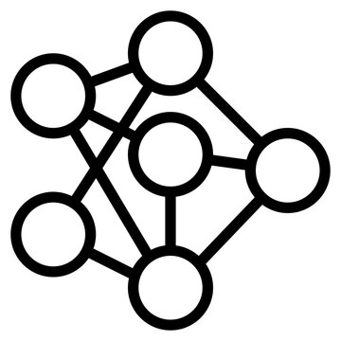

Tools
+
LLM
Agent
Agentic AI

Slide 3
Multi-tool Agent
via states

Slide 4
Multiple Focuse, Single-Tool
Agents
via states or A2A

Slide 5
Agent
Equipped with
MCP Servers as Tools
via MCP

Slide 6
Agentic Mesh
Orchestrated Agents
Agent + tools
Workflows
(graphs)
Prompt

Slide 7
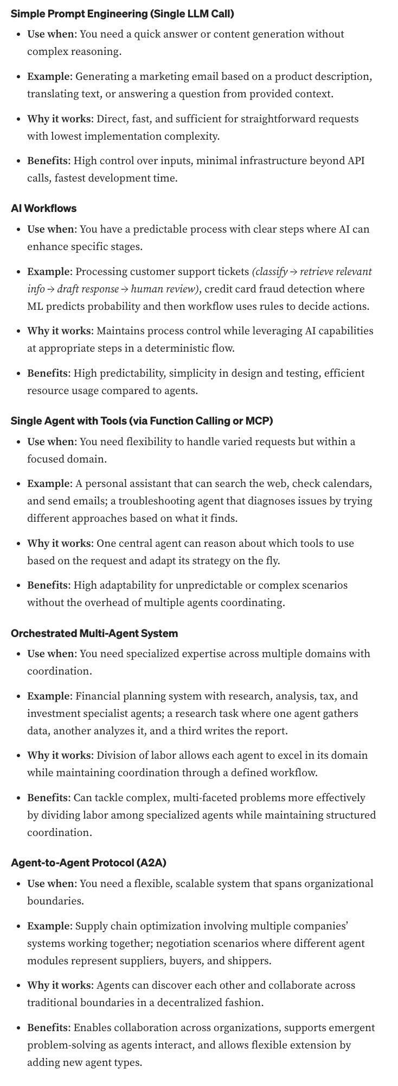
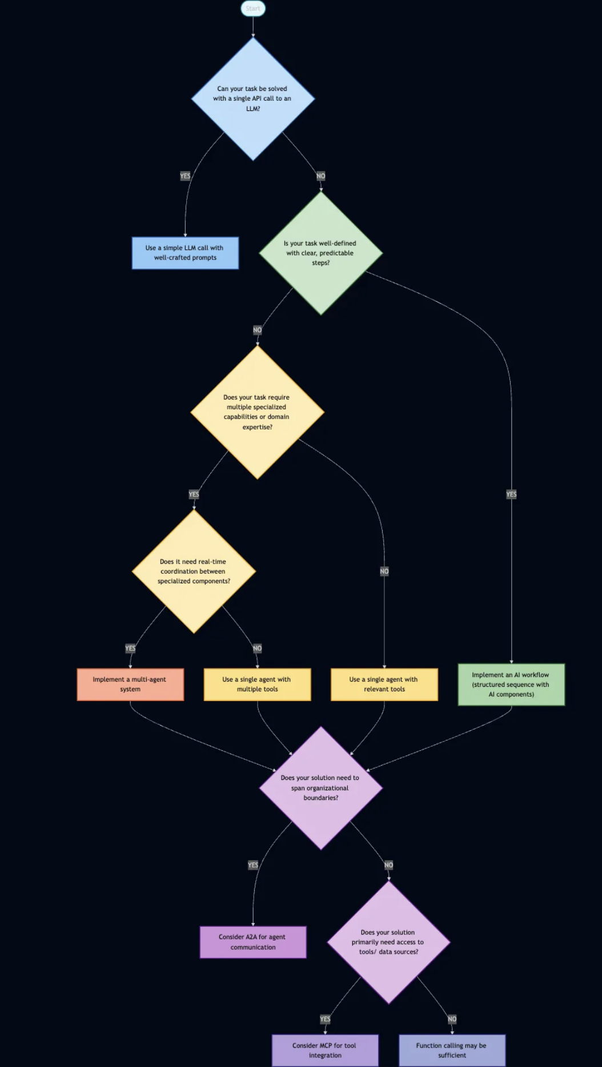
https://medium.com/data-science-collective/mcp-vs-a2a-building-bridges-between-ai-agents-f6b64be97a35

